Slide 1

SEND at The King’s C of E Primary
AND THE SUPPORT FOR DISADVANTAGED PUPILS
STAFF HANDBOOK
KEY GUIDANCE AND INFORMATION FOR ALL STAFF
2024-2025
Notes:
Skip through and discuss teacher roles.

Slide 2

Living Well Together
Vision Statement
Growing confident and aspirational children who believe in themselves and contribute positively to their community and the wider world.
Mission
Our Mission is to ensure that:
All children develop the knowledge, skills and character to live happy, healthy and successful lives
All children are respected and treated with equity
All children are taught to be resilient and aspirational, encouraging them all to achieve their full potential
All children know that they have a positive role to play in the world and that their contributions are valued in the community
All children are encouraged in their personal, moral and spiritual development within a Christian framework.
Our Core Values
Kindness
Learning respectfully alongside each other, helping each other to grow through our acts of kindness.
“Do for other people the same things you want them to do for you.”
Matthew 7 v 12
Friendship
United as a family we bring light to our community and the wider world.
“A sweet friendship refreshes the soul.”
Proverbs 27 v 9
Faith
Aspiring to learn with courage and faith, believing in God, ourselves and each other so that we can live life in all its fullness
“Faith can move mountains”.
Matthew 17 v 20

Slide 3
CURRICULUM OFFER
“
OUR MORAL COMPASS AND INTENT
Create a positive and supportive environment for all pupils without exception
The King’s Church of England Academy is inclusive and fully committed to ensuring that all students achieve their best. The academy endeavours to provide a range of support to meet the needs of every individual. Students at The King’s Church of England Academy receive support to overcome difficulties they may have due their special educational needs and disabilities along with challenge to ensure they achieve their very best in all aspects of their development. The academy promotes an inclusive ethos where students are aware of the diverse needs of others in the community.
“

Slide 4


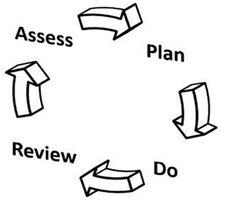


OUR SCHOOL COHORT
BREAKDOWN FOR THE 2024 –2025 COHORT
There are four broad areas of need within SEND:
Cognition and Learning Needs
Communication and Interaction Needs
Social, Emotional and Mental Health Needs
Sensory and/ or Physical Needs
As stated in the Code of Practice:
“These four broad areas give an overview of the range of needs that should be planned for. The purpose of identification is to work out what action the school needs to take, not to fit a pupil into a category. In practice, individual children or young people often have needs that cut across all these areas and their needs may change over time. For instance speech, language and communication needs can also be a feature of a number of other areas of SEN, and children and young people with an Autistic Spectrum Disorder (ASD) may have needs across all areas, including particular sensory requirements. The support provided to an individual should always be based on a full understanding of their particular strengths and needs and seek to address them all using well-evidenced interventions targeted at their areas of difficulty and where necessary specialist equipment or software”
.
We have 60 students with SEND. This will change throughout the year and you will be updated termly.
This equates to 27% of our school population (224 at present on roll)
There are 13 students with EHCPs. This equates to 6% of our school population. The national average is 4.8% (an increase of 0.5% on last year).
There are 36 boys on our register and 24 girls.

Slide 5
SEND STRATEGY
THE IMPLEMENTATION OF OUR PROVISION
CREATE A POSITIVE AND SUPPORTIVE ENVIRONMENT FOR ALL PUPILS WITHOUT EXCEPTION - An inclusive school removes barriers to learning and participation, provides an education that is appropriate to pupils’ needs, and promotes high standards and the fulfilment of potential for all pupils. We should:
promote positive relationships, active engagement, and wellbeing for all pupils;
ensure all pupils can access the best possible teaching;
adopt a positive and proactive approach to behaviour
BUILD AN ONGONG, HOLISTIC UNDERSTANDING OF YOUR PUPILS AND THEIR NEEDS - We should aim to understand individual pupil’s learning needs using the graduated approach of the ‘assess, plan, do, review’ approach.
Assessment should be regular and purposeful rather than a one-off event, and should seek input from parents and care givers as well as the pupil themselves and specialist professionals. Teachers need to feel empowered and trusted to use the information they collect to make a decision about the next steps for teaching that child.
ENSURE ALL PUPILS HAVE ACCESS TO HIGH QUALITY TEACHING - Good teaching for pupils with SEND is good teaching for all. Searching for a ‘magic bullet’ can distract teachers from the powerful strategies they often already possess. Teachers should develop a repertoire of these strategies they can use flexibly in response to the needs of all pupils.
flexible grouping;
cognitive and metacognitive strategies;
explicit instruction;
using technology to support pupils with SEND;
Scaffolding and small steps
COMPLIMENT HIGH QUALITY TEACHING WITH SELECTED SMALL GROUP AND ONE-TO-ONE INTERVENTIONS - Small-group and one-to-one interventions can be a powerful tool but must be used carefully. Ineffective use of interventions can create a barrier to the inclusion of pupils with SEN. High quality teaching should reduce the need for extra support, but it is likely that some pupils will require high quality, structured, targeted interventions to make progress. The intensity of intervention (from universal to targeted to specialist) should increase with need. Interventions should be carefully targeted through identification and assessment of need.
WORK EFFECTIVELY WITH LEARNING SUPPORT ASSISTANTS - Effective deployment of Teaching assistants critical. School leaders should pay careful attention to the roles of TA’S and ensure they have a positive impact on pupils with SEND. TA’s should supplement, not replace, teaching from the classroom teacher.

Slide 6
SEND STRATEGY
THE IMPLEMENTATION OF OUR PROVISION
LEADERSHIP STRUCTURE -Our Deputy Head (Miss Jeffery) is accountable for SEND and provision and tracks/support all pupils with SEN. We have a team of Teaching Assistants who support children within the classroom and run a variety of targeted interventions.
GRADUATED RESPONSE OF SUPPORT - ASSESS, PLAN, DO, REVIEW
Where a pupil is identified as having SEN, we should take action to remove barriers to learning and put effective special educational provision in place. SEN support should take the form of a four-part cycle through which earlier decisions and actions are revisited, refined and revised with a growing understanding of the pupil’s needs and of what supports the pupil in making good progress and securing good outcomes. This is known as the graduated approach.
PROVISION MAP - Our provision map tracks and assesses the interventions that are used each term for individual pupils, classes and cohorts. This allows us to identify and break down individual barriers to learning for each pupil across all subjects in an effective way. This support is used to ‘level the playing field’ by providing additional support in accessing the curriculum and plug gaps in knowledge.
CHILD CENTRED REVIEWS -Pupils' outcomes and aspirations are at the
heart of SEND provision. The child centered review (CCR) will help you maintain a child-centered approach. The CCR is not an IEP with a different name: it’s about a change in culture. It is designed with personalised targets for every child identified with SEN and monitors the effectiveness of support. This is a holistic approach which focuses on support for the child’s specific SEN need and is created with the support of the child, parents/care givers and Teaching staff. These must be completed termly and in consultation with parents.
LEARNING PLANS –should consider the needs of every child and allow all children to access the same learning objective in a range of differentiated styles to best suit. This should be evident in lessons and in within the child's work.Parental contribution is welcomed through discussion with teaching staff. This may help our staff better support children.

Slide 7
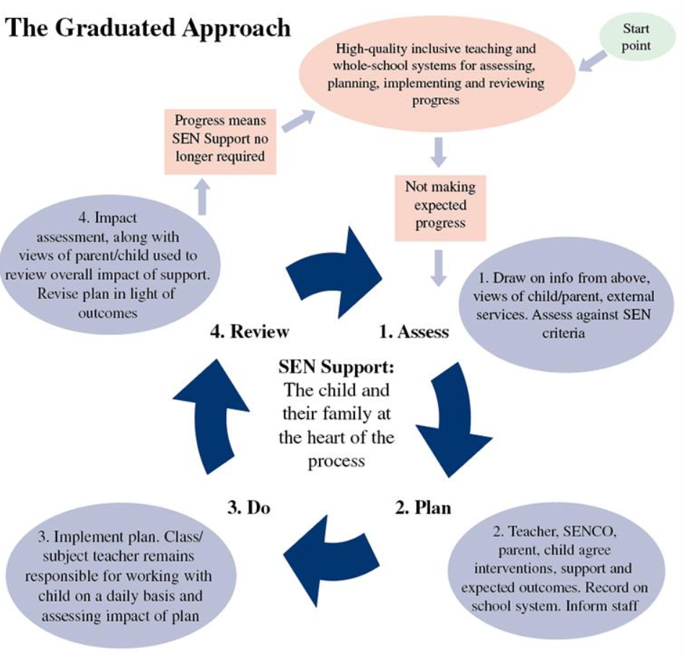
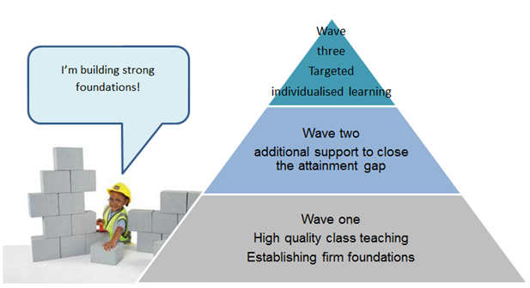
The Graduated Response
Waves of Intervention
05

Slide 8
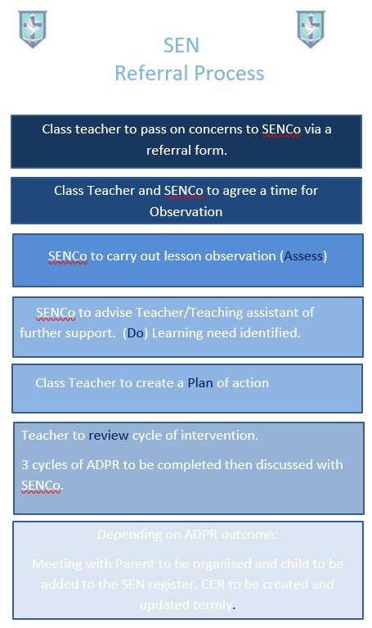
05
Notes:
Bring me evidence of concerns

Slide 9
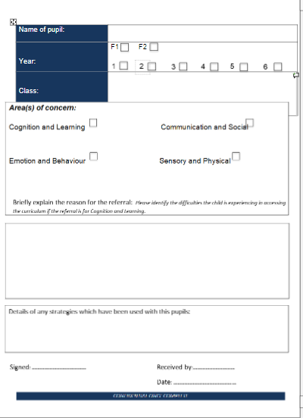

Slide 10
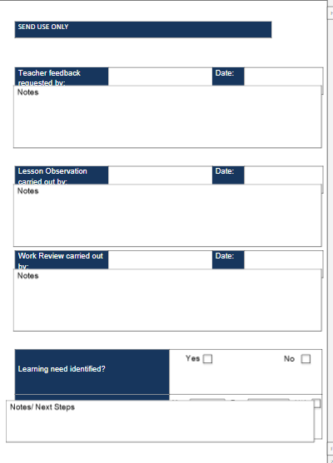
Attach EVIDENCE

Slide 11
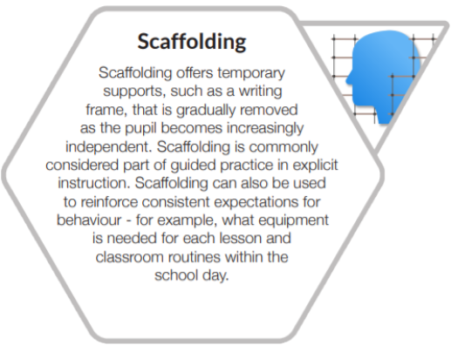
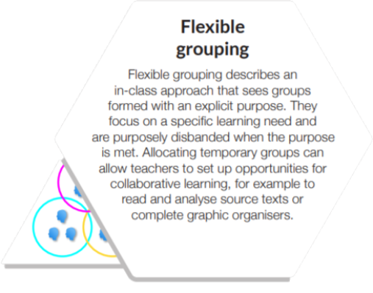
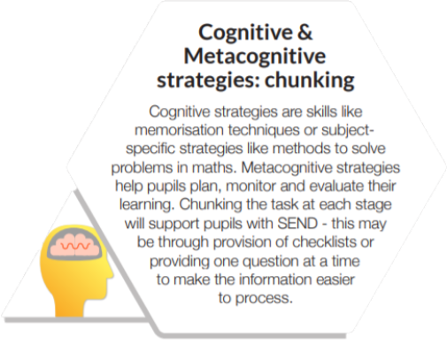
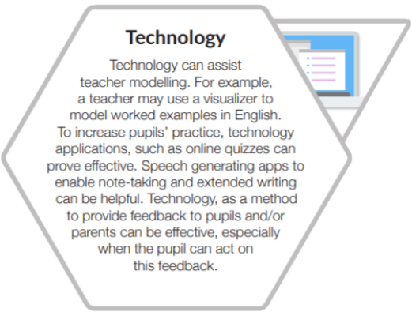
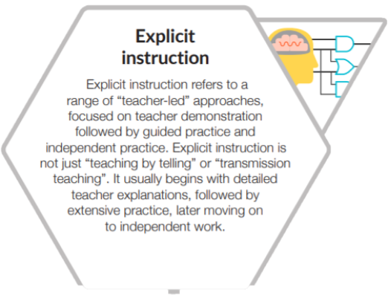
TEACHING AND LEARNING
THE IMPLEMENTATION OF OUR PROVISION
Improving high quality teaching for all pupils will improve outcomes for pupils with SEND. Teachers should develop a repertoire of these strategies they can use flexibly in response to individual needs and use them as the starting point for classroom teaching for all pupils, including those with SEND.

Slide 12


TEACHING AND LEARNING
The non-negotiables: What you are expected to do
In relation to children/young people at risk of or with special educational needs/disabilities, class and subject teachers should: Ensure early identification of:
special educational needs;
          barriers to learning;
          appropriate interventions and actions (eg ‘graduated approach’, ‘SEN support’) in consultation with the SENCO;
    Have full knowledge of children’s/young people’s ‘SEN support’ or Education, Health and Care Plans;
      Provide access to a broad and balanced curriculum;
      Understand and provide ‘high quality teaching’;
      Have appropriate high expectations based on assessment;
      Assume responsibility and accountability for their learning, progress and development;
      Maintain responsibility for working with them on a daily basis, even when interventions involve group or one-to-one teaching/support away from the main class;
      Regularly assess, monitor and review their progress (academic, developmental and social-emotional) during the course of the year with a view to ensuring the ultimate outcome of ‘a successful transition to adult life’
YOUR ROLE AS A TEACHER
Your main role is to help identify and overcome barriers to learning inside and outside the classroom.
Teachers are responsible and accountable for the progress and development of the pupils in their class, including where pupils access support from Teaching Assistants or specialist staff.
Teachers should work closely with any Teaching Assistants or specialist staff involved, to plan and assess the impact of support and interventions and how they can be linked to classroom teaching.
Working with the SENCO, teachers should revise the support in light of the pupil’s progress and development, deciding on any changes to the support and outcomes in consultation with the parent and pupil.
Through professional development, secure knowledge, understanding and skills around SEND

Slide 13
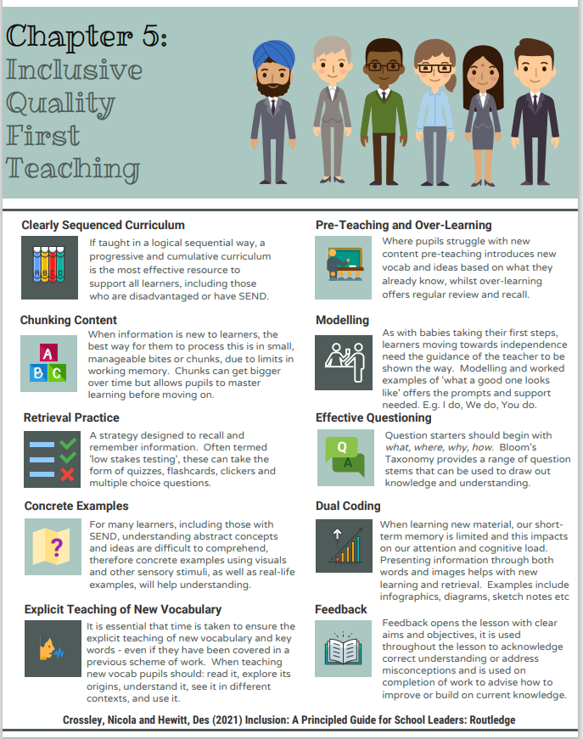
Quality First Teaching Expectations

Slide 14
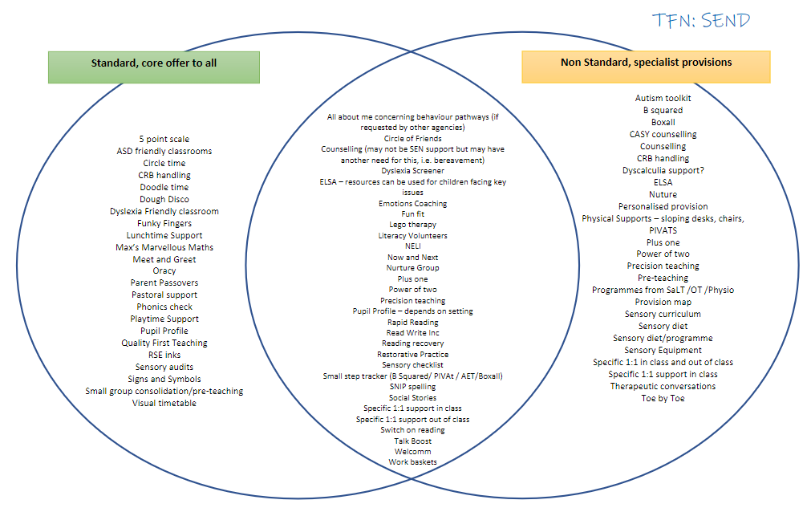
Core offer and Non Standard, Specialist Provision.

Slide 15
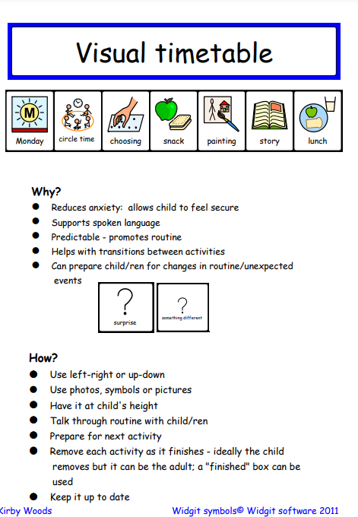
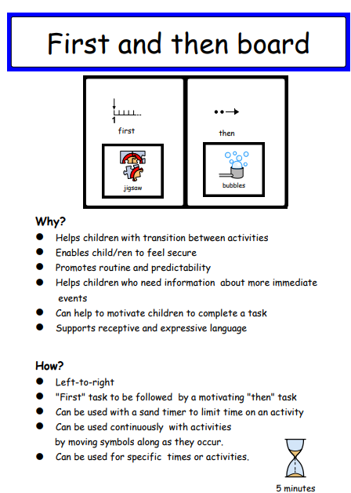

Slide 16
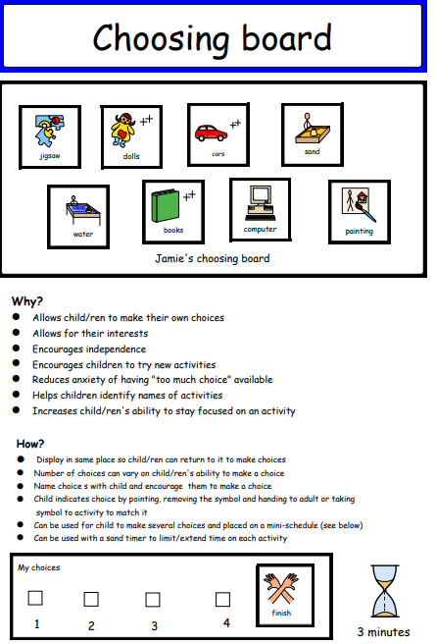

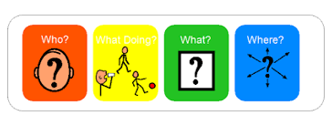

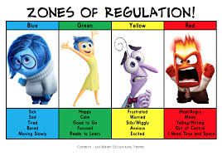

Slide 17
Child Centred Review (CCR)
To be completed WITH parents/carers every term (3x per year ) signed by both yourselves and parent/carer and 2 of which can be completed in parents evening meetings. (Meeting time to be extended).
Please upload to CPOMS. Targets should be adapted every half term to show graduated response. Explain this to parents in meetings and any changed targets will be shared in the next meeting unless parents specify otherwise.

Slide 18
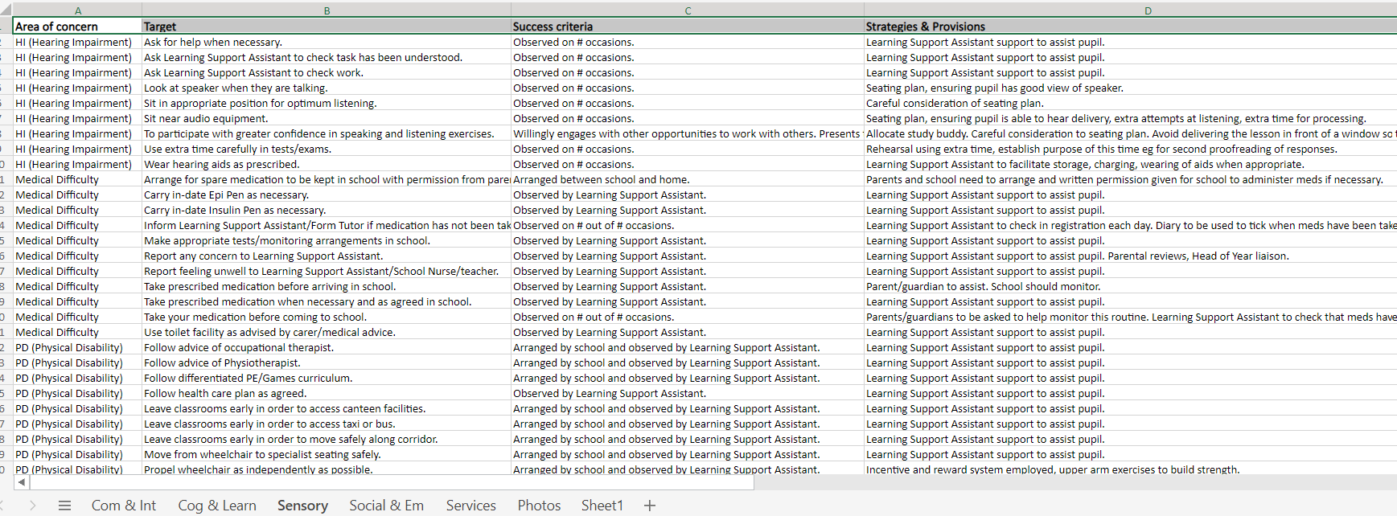
You DO NOT need to rewrite these from scratch each time. Comments can be tweaked at each review as needed but Targets must be reviewed. Targets should be SMART and matched to SEN need and only academic if the primary/secondary SEN need is cognition and learning.
See Smart Excel document in SEN CCR file. This document provides targets for each SEN need as well as success criteria, strategies and provision ideas.
S specific
M measurable
A achievable
R relevant
T time-bound.

Slide 19
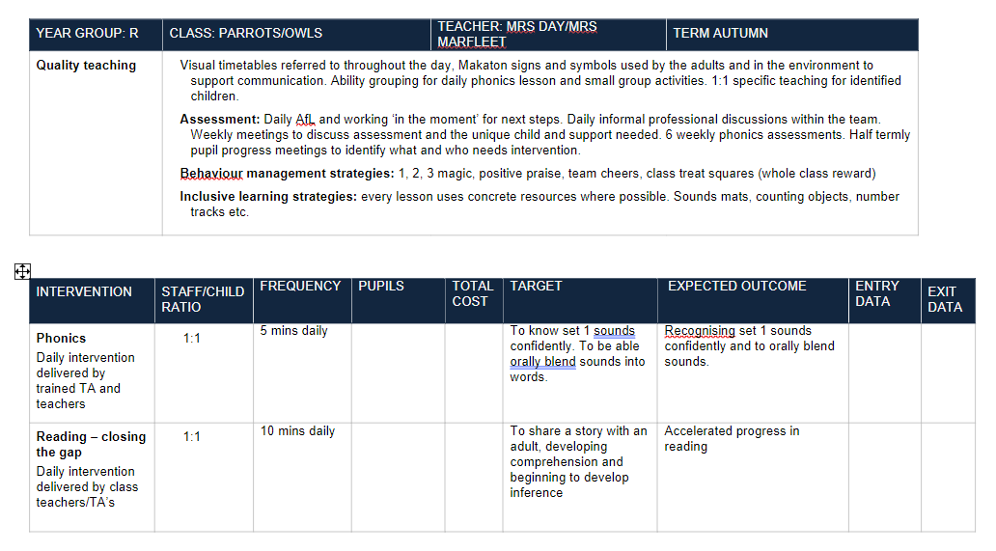
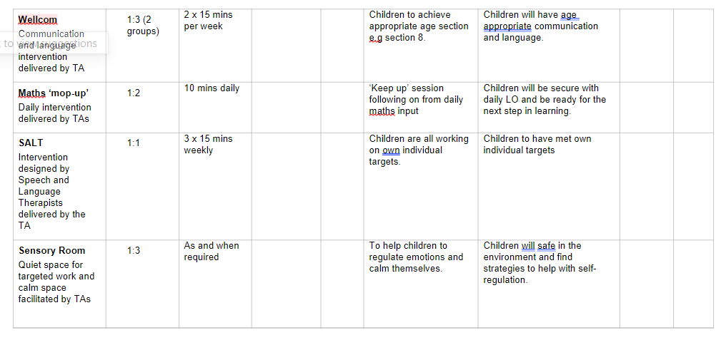
Provision maps should be updated every half term. Please refer to core-non core document to see if this counts as an intervention. Interventions must meet CCR targets.. I have set one up ready to be completed on Teams-Provision-2023/2024. There are examples of provision-please delete as appropriate,

Slide 20

https://www.motional.io/
This is for children who have been identified with SEMH needs.
This needs completing a minimum of 3 times per year. This assessment is used for deciding if a child is suitable for Peacocks or Falcons and must be completed by the teacher as a baseline for concerns. Not all children will fit the criteria for created provision or nurture but this supports the graduated response.
Please complete as evidence if you feel a child who is exhibiting these needs as evidence for SENCo referral.
You do not need to upload these as they are saved on the site.

Slide 21

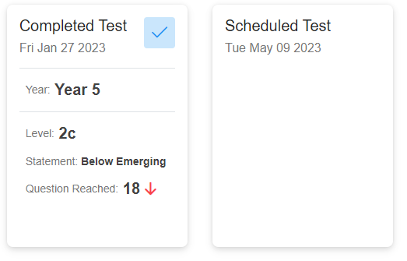
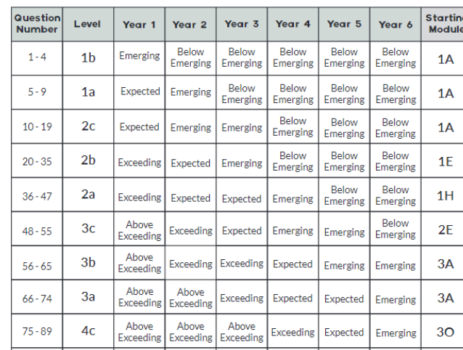
All guidance is in resources on the website.Please access resources tab help guides and videos.
https://idlsgroup.com/
LOGIN: admin@NG244HU Password Kings2024!
To add a child go to:
People-new child-complete the child’s details-then go to manage-enrol in as many required-turn settings and progress on-do not turn on ‘book’-then add the child to designated group.
To start:
Assessment needs to be completed first for both Literacy and Numeracy
Numeracy-completed by the child online ( child cannot have help) headphones are needed or a quiet space. They can pause and come back to the test at anytime.
To track progress and schedule a test each half term.
Click on the child-numeracy-full and detailed progress-tests
To understand assessment grade:
Go to home tab-resources-Numeracy placement test guide-page 2.
This helps to track progress. This can then be added to provision map entry data box.
A programme of activities will be set up for each child to complete independently.
Literacy-reading and spelling test to be completed with adult support to implement the assessment these scores must be uploaded onto the test scores before the child can start. Before they start, an adult must support them in choosing colours for the programme based on the child’s preference.

Slide 22

Autism Progression Framework
The file for this is in the SEN teams folder. Please complete an assessment for any child with Autism within your class. An initial base line should be completed ASAP.
Then another assessment for each whole term.
You DO NOT need to fill in every section. Only the sections the child is showing SEN needs in.
When this is complete-please save in the AET progression file using only initials in your class file
This document is crucial for assessment for children with Autism in our school.

Slide 23
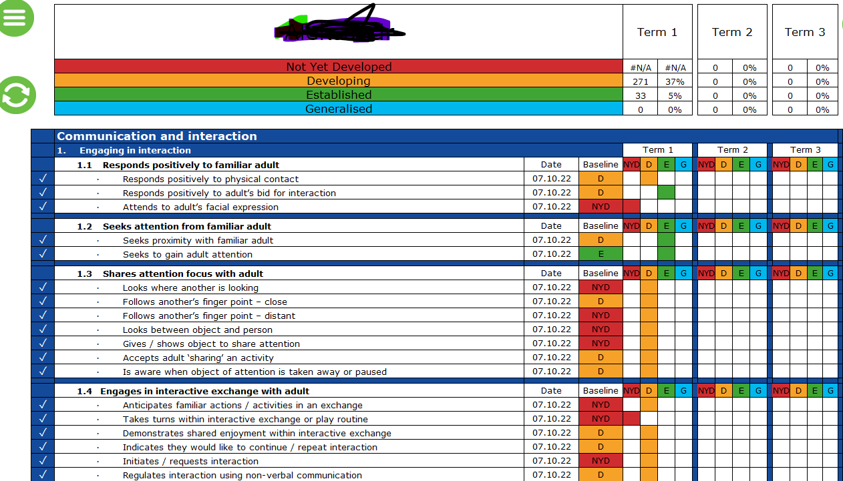
Click on the little house Icon- Type name-term 1-personalised learning intentions.
Click on the box you want to fill in and choose y for yes or n for no
Please the complete again for Autumn/Spring/Summer term..
Save each one in your AET class file in SEN AET file on Teams.
Initials only!

Slide 24
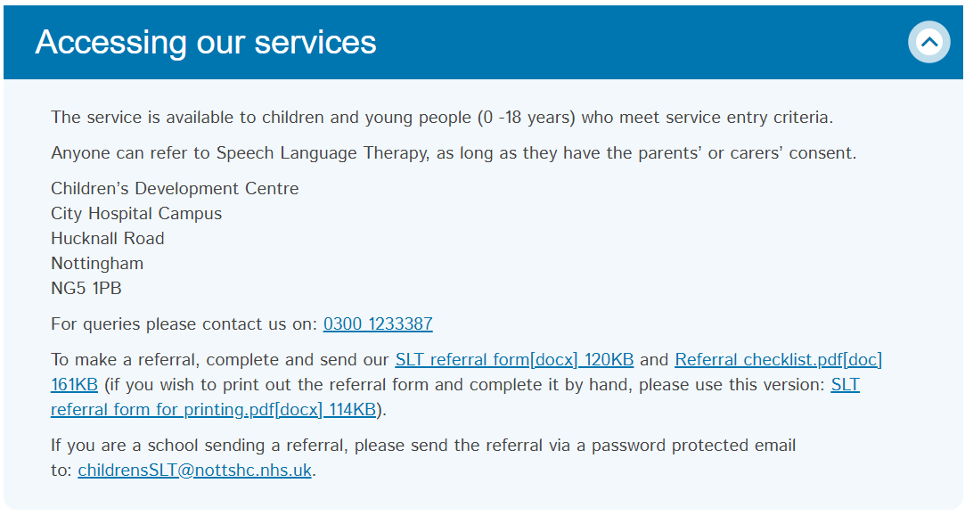
Speech and Language referrals
Many children have SALT referrals in our school if you feel a child requires a SALT referral – please complete the following steps. Teacher and TA’s can do these. Please upload any referral to CPOMS so Miss Jeffery can monitor these. I have downloaded the forms and checklist in the SEN SALT file.

Slide 25
Who are your SEN children in your class?
To find who the children are in your class at present.
Please do the following :
Login to SchloarPack
Choose reporting
Choose data playground
Choose your class name
This will give a visual list
To see your class list of SEN children and their needs:
Choose reporting
Choose SEN
Filter to your class name.
Codes explained on next slide.

Slide 26


